Slide 1


TELECOM Project
Setup environment and Build data warehouse
1st meeting
2022.06.26 by David yang

Slide 2
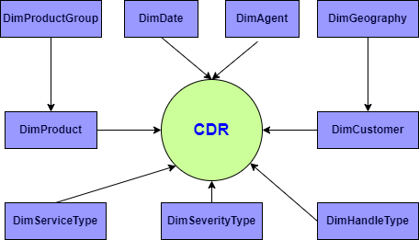
Concept Model

Slide 3
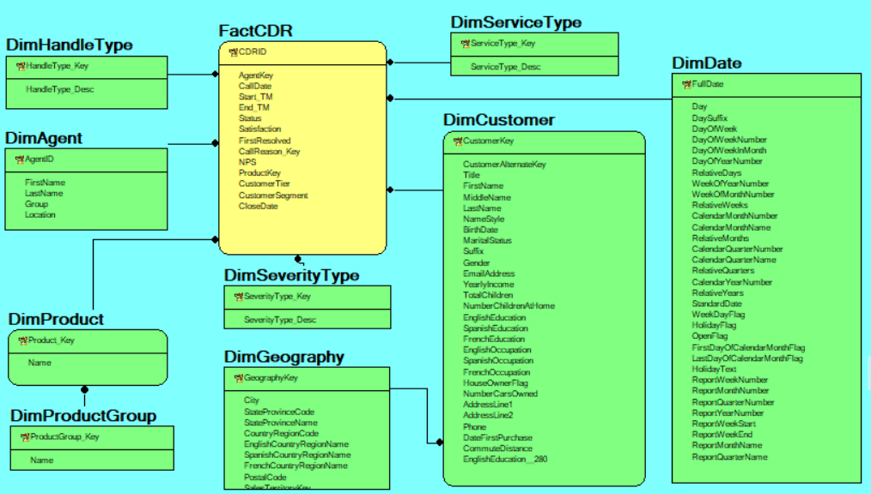
Logical Model

Slide 4
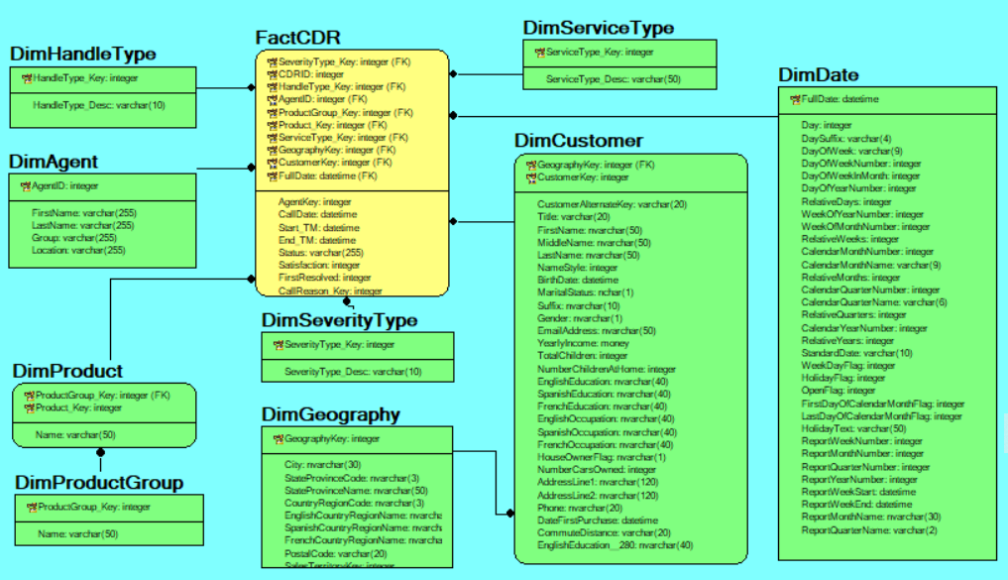
Physical Model

Slide 5
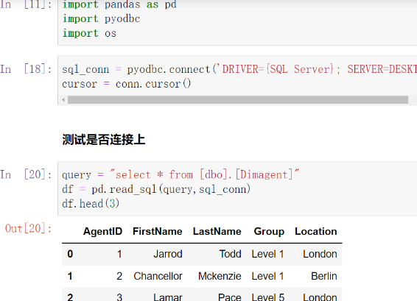
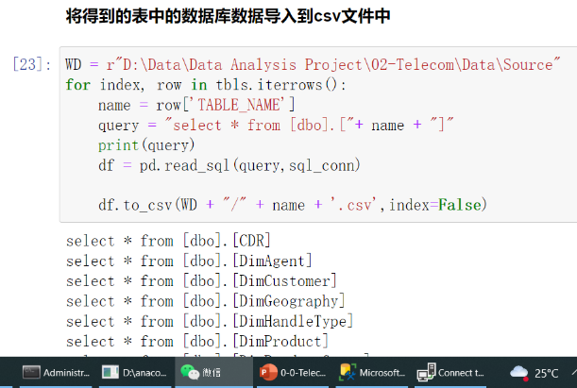
Connect between SQL Server and Python

Slide 6
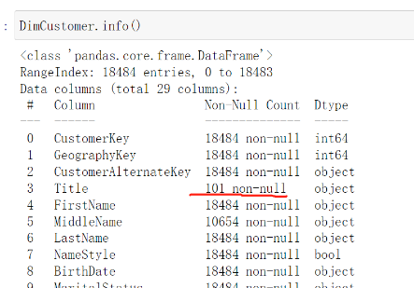
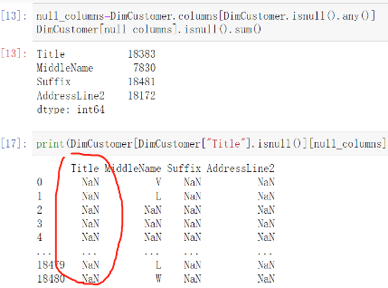
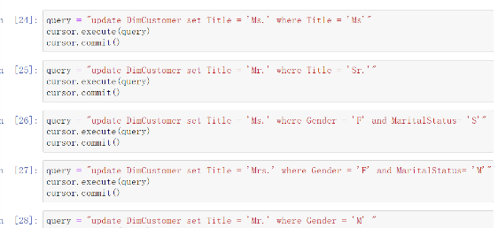
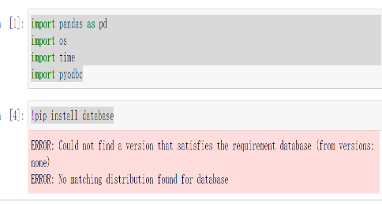
Cleaning the DimCustomer Table

Slide 7

Agenda
Pre-processing data with Python
Data-Load into DW Database
Data Visualization
ETL Tableau
2nd meeting
2022.07.10 by David yang

Slide 8
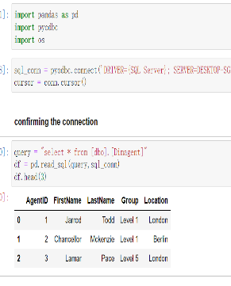
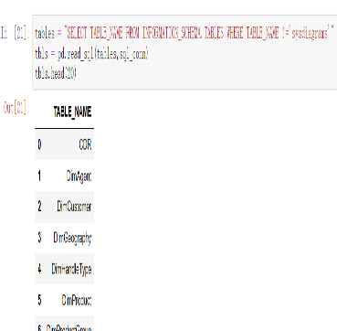
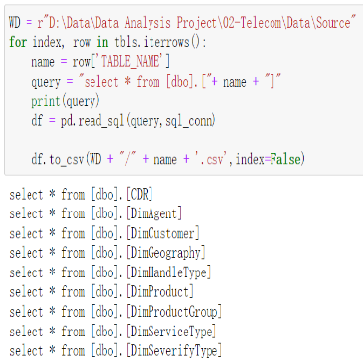
Import data from .csv into Python

Slide 9
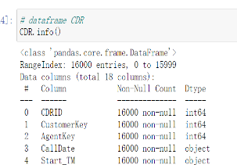
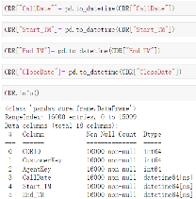
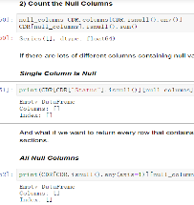
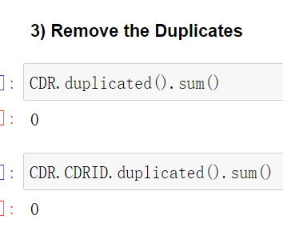
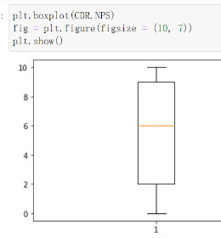
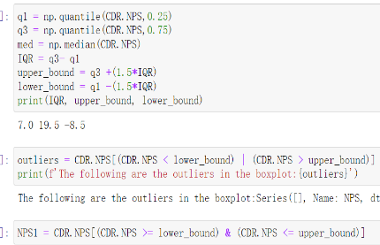
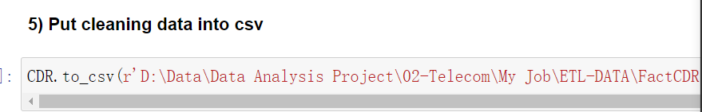
Data Cleasing ----FactCDR
Data overview
Fixe the datetime type
Check for null values
Check the duplicates
Boxplot
Detecting outliers ---IQR rules
Put cleaning data into csv

Slide 10
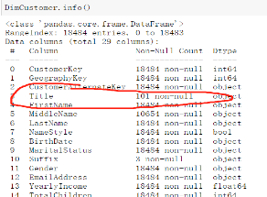
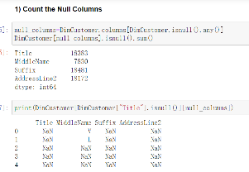
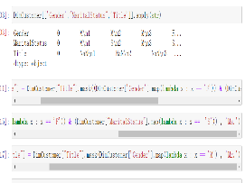
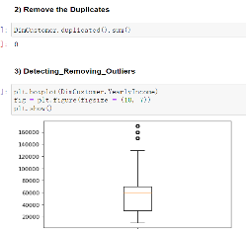
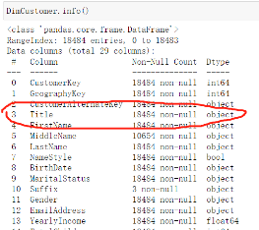
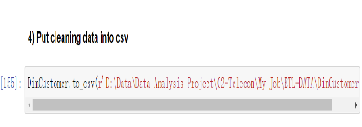
Data Cleasing ----DimCustomer
Data overview
Check for null values
Missing value handling
Duplicates and Outliers handling
Confirm the handling
Put cleaning data into csv

Slide 11
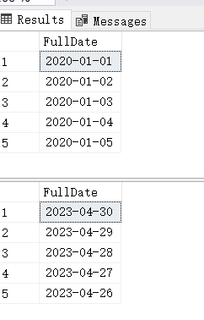
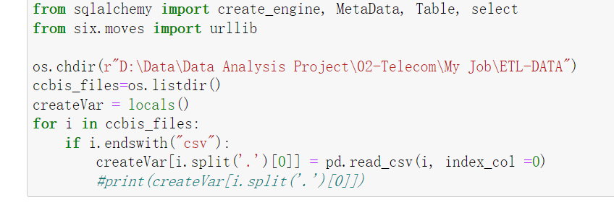
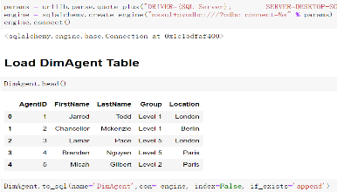
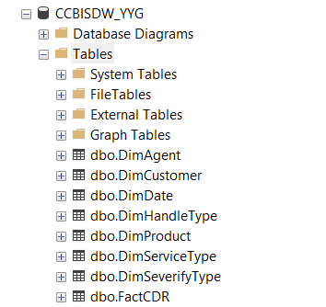
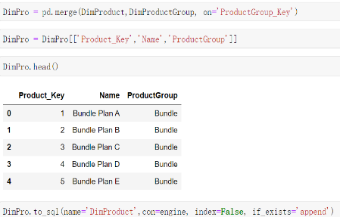
Data validation & Data-Load into DW Database
Datetime Fixed
Generate dataframe from CSV
Create a database connection engine
Combinate tables

Slide 12
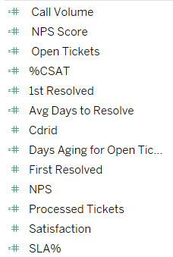
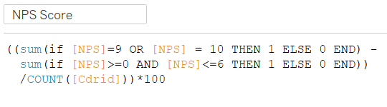
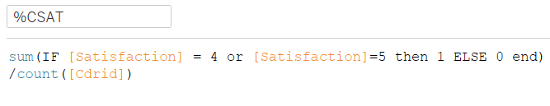
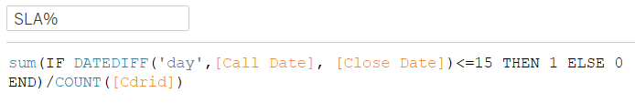
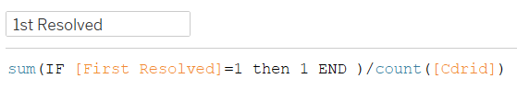
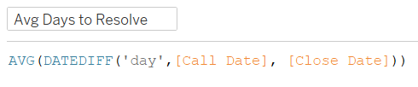
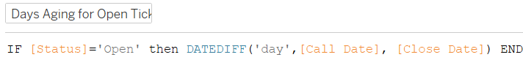
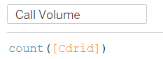
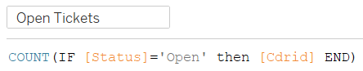
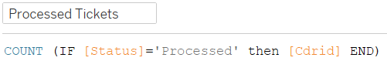
Prepare data sets for reporting and analysis
Net Promoter Score (NPS)
Satisfaction
First Resolved
Cdrid

Slide 13
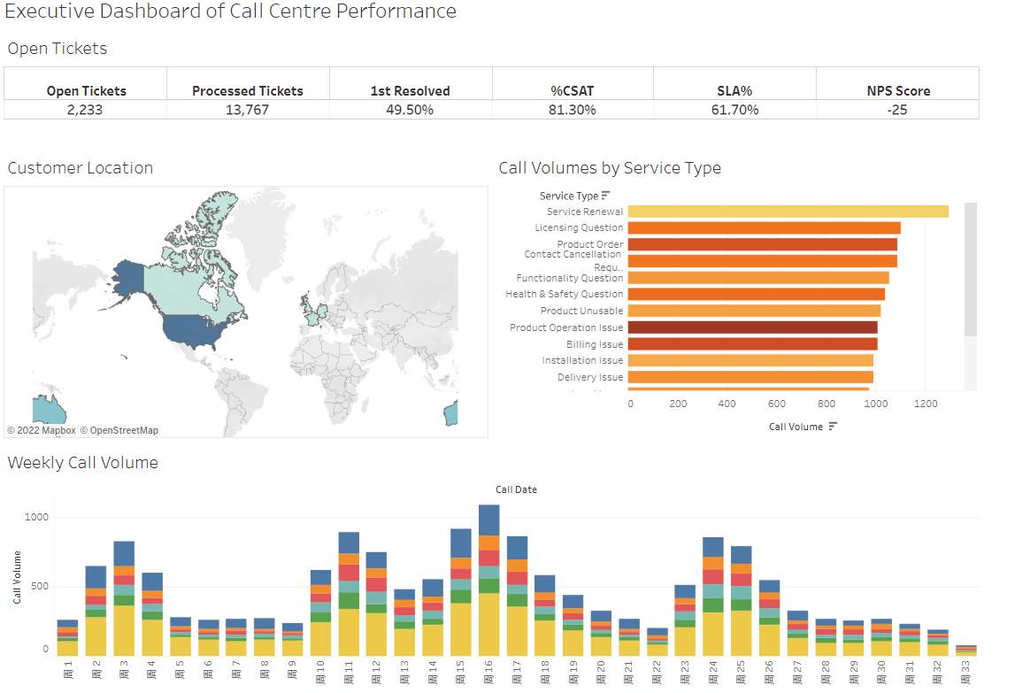
Data validation

Slide 14
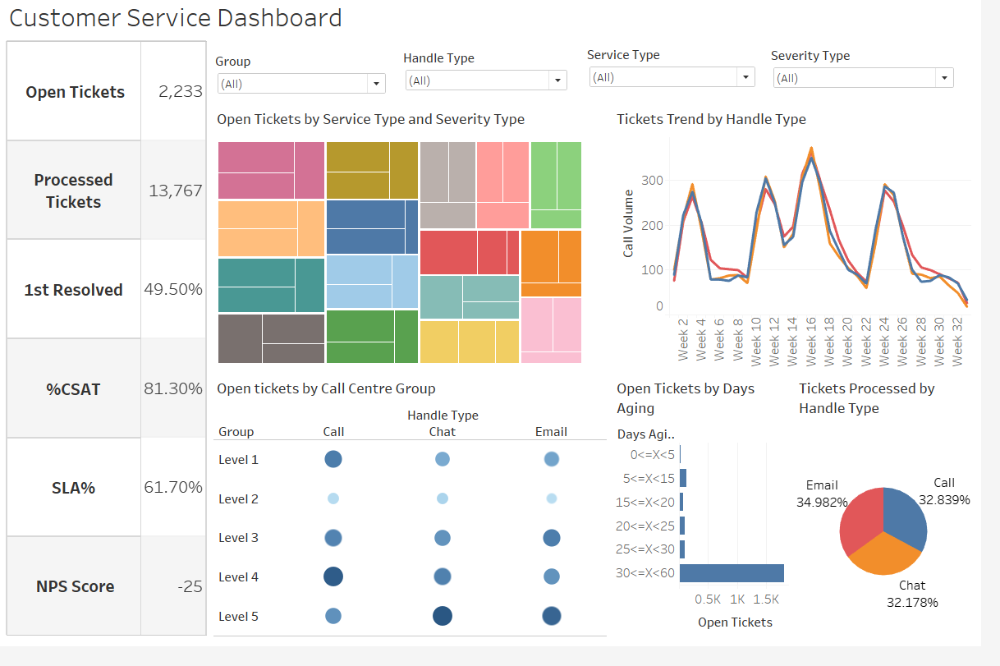

Slide 15
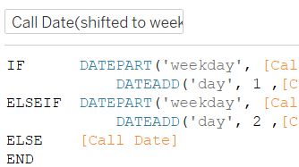
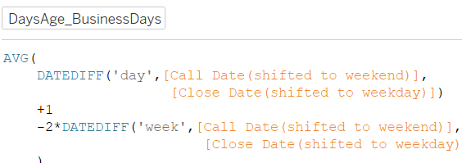
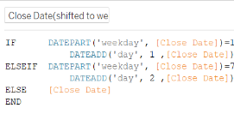
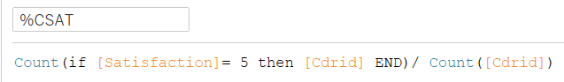
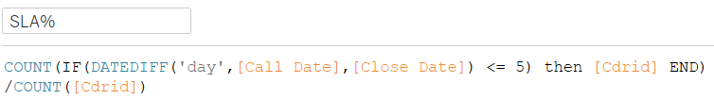
Prepare data sets for reporting and analysis

Slide 16
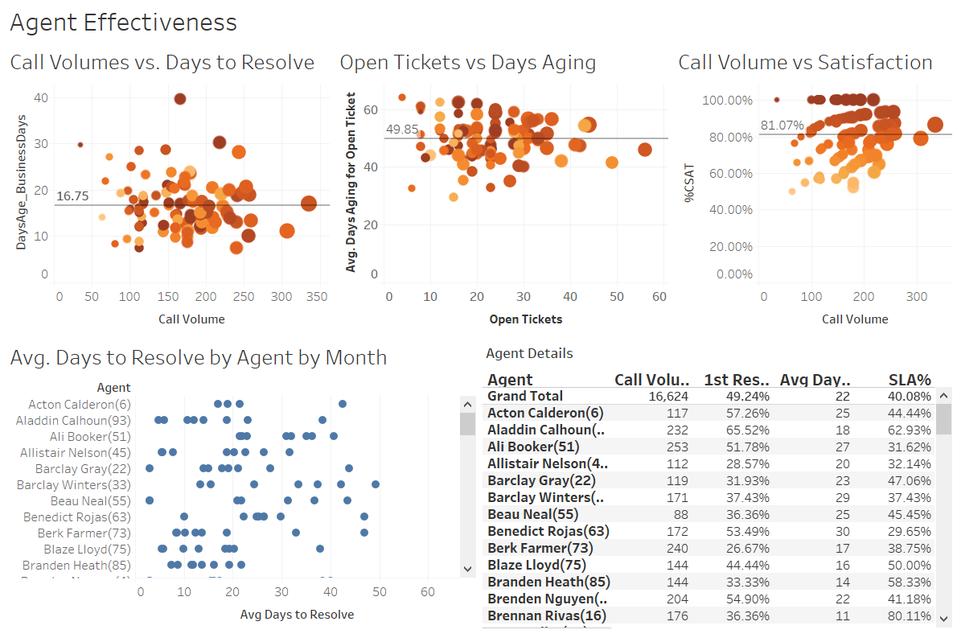

Slide 17
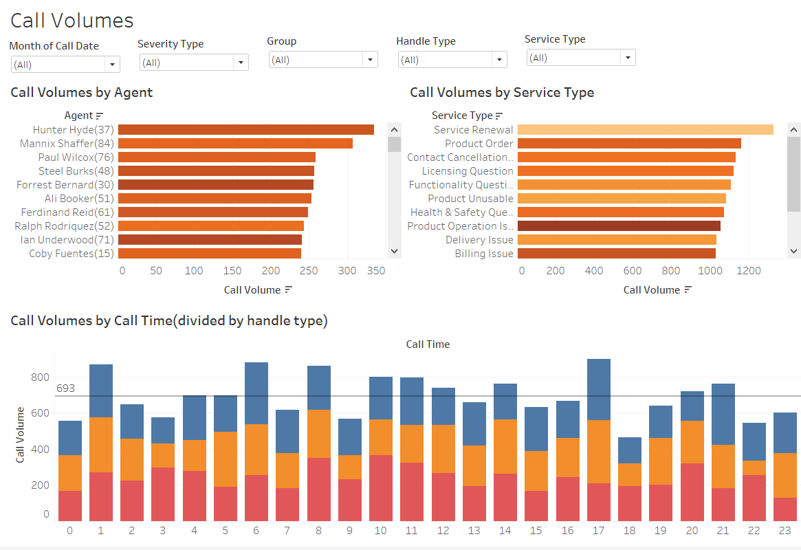

Slide 18
Agenda
Telecom Data Visualization
Telecom Churn Analysis
Retails RFM Analysis
Data Visualization
3rd meeting
2022.07.17 by David yang

Slide 19
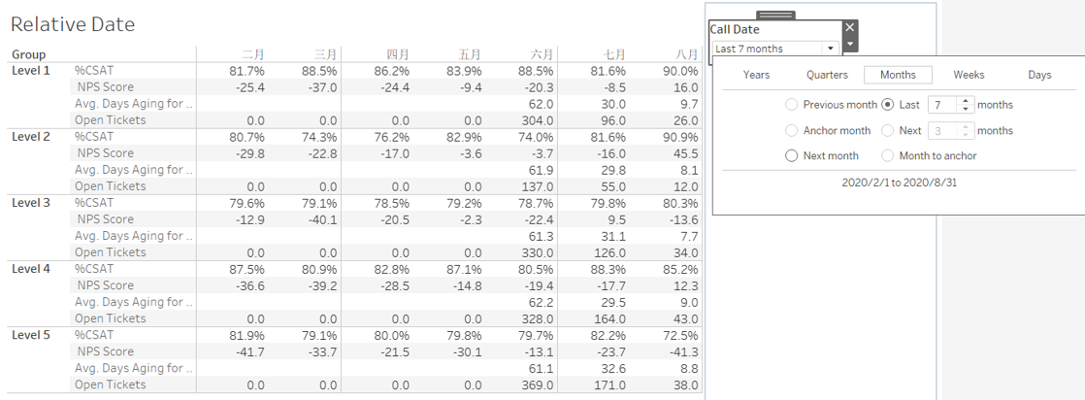
Telecom Data Visualization---Relative Date

Slide 20

Telecom Data Visualization---Last N Report Weeks

Slide 21

Telecom Data Visualization---Executive Dashboard

Slide 22

Telecom Churn Analysis 1

Slide 23

Telecom Churn Analysis 2

Slide 24

Telecom Churn Analysis 2

Slide 25

Telecom Churn Analysis 3

Slide 26

Retails RFM Analysis

Slide 27

Thanks

